Slide 1
Session 3.2 CSS 3 Properties Borders, Background & Fonts

Slide 2
Contents
CSS3 Borders
CSS3 Background
CSS3 Fonts and @font-face
Designing links using CSS3
Using Google Fonts

Slide 3
CSS Borders
Borders have 3 specifications
Size
Style
Width
New Border properties in CSS3
Border-radius & box-shadow

Slide 4
Border-radius property
The border-radius CSS property allows Web authors to define how rounded border corners are. The curve of each corner is defined using one or two radii, defining its shape: circle or ellipse.
#example1
{ border-radius: 15px; }
Rounder corners can be created independently using the four individual border-*-radius properties (border-bottom-left-radius, border-top-left-radius, etc.)

Slide 5
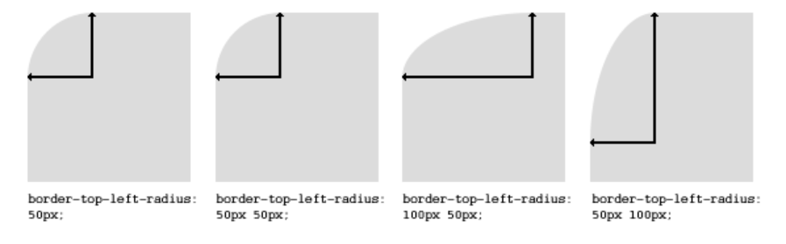
Border-radius property
border-top-left-radius: 10px 5px; border-bottom-right-radius: 10% 5%; border-top-right-radius: 10px;

Slide 6
Box-shadow property
The horizontal offset of the shadow, positive means the shadow will be on the right of the box, a negative offset will put the shadow on the left of the box.
The vertical offset of the shadow, a negative one means the box-shadow will be above the box, a positive one means the shadow will be below the box.
The blur radius (optional), if set to 0 the shadow will be sharp, the higher the number, the more blurred it will be.
The spread radius (optional), positive values increase the size of the shadow, negative values decrease the size. Default is 0 (the shadow is same size as blur).
Color
box-shadow: 3px 3px 5px 6px #ccc;

Slide 7
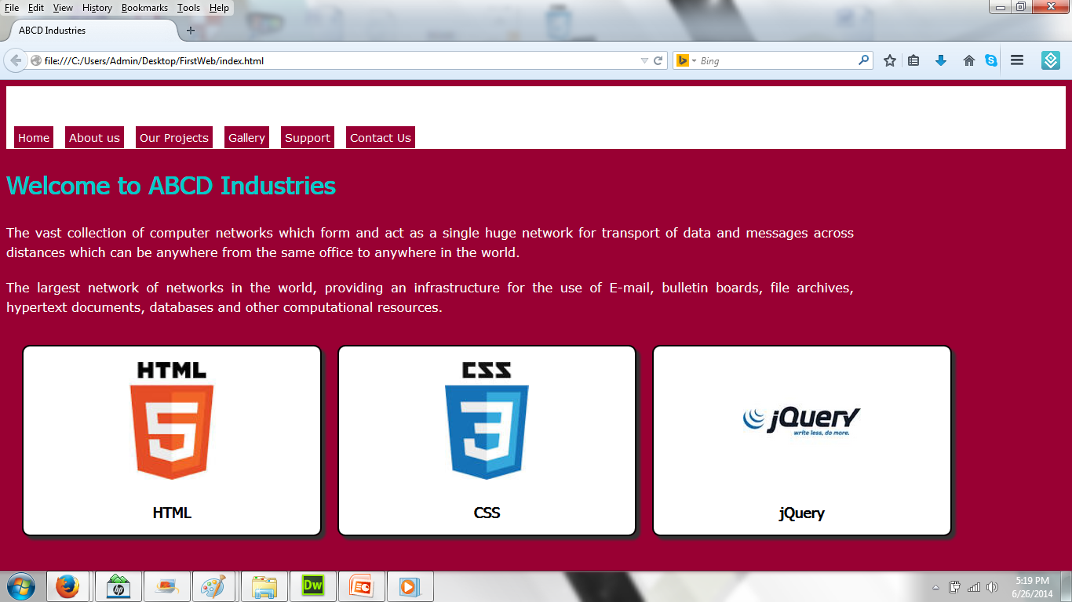
Example of Border radius and Box-shadow

Slide 8
Example of Border radius and Box-shadow
<div class="boxes">
<img height="150" src="images/html-logo.jpg" alt="HTML Logo">
<h3>HTML</h3>
</div>
<div class="boxes">
<img height="150" src="images/CSS3-logo.jpg" alt="CSS3 Logo">
<h3>CSS</h3>
</div>
<div class="boxes">
<img height="150" src="images/jQuery-logo.jpg" alt="jQuery Logo">
<h3>jQuery</h3>
</div>

Slide 9
Example of Border radius and Box-shadow
.boxes
{ background-color:#FFF;
width:25%;
height:200px;
padding:20px;
text-align:center;
float:left;
margin-left:20px;
margin-top:20px;
margin-bottom:20px;
border:solid 2px #000;
border-radius:10px;
box-shadow:5px 5px 2px #333;
}

Slide 10
CSS Backgrounds
Background is very useful in creative designing
Background properties:
Color, size, repeat and multiple images
Demo

Slide 11
CSS Backgrounds
header
{
background-image:url(../images/background.jpg);
background-position:left top;
background-size:450px 150px;
background-repeat:repeat;
width:100%;
height:80px;
}

Slide 12
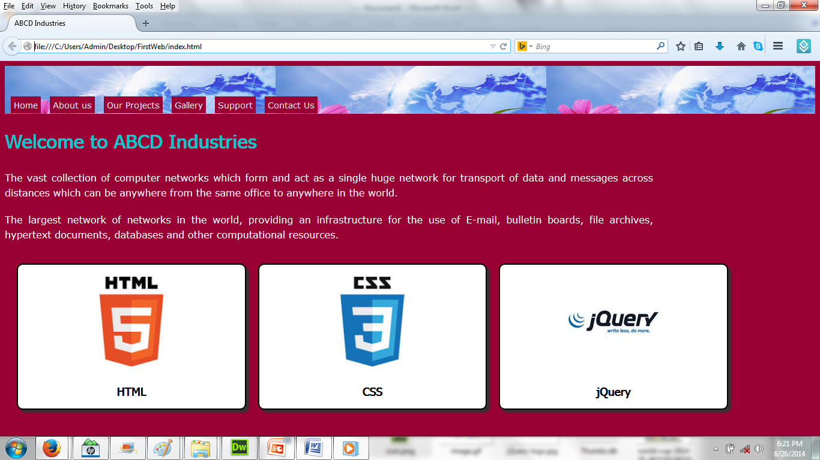
CSS Backgrounds
Background Image

Slide 13
<div id="largebg">
</div>
#largebg{
background:url(../images/back.gif)
left top no-repeat;
width:10000px;
height:300px;
margin-top:20px;
}

Slide 14


Slide 15
CSS Fonts and @font-face
Font-family defines the font
Fonts must be web safe
CSS3 allows us to define our own fonts
Using @font-face directive
Demo
Notes:
Generally speaking, the best web safe fonts that are also accessible are: Arial (sans serif) Arial Black (sans serif) Tahoma (sans serif)
Web-safe fonts are fonts that can adapt to any browser on any device. By using these types of fonts, web designers and developers ensure that the intended font will always be displayed properly on a web page, even if these fonts aren't installed on the user's computer.

Slide 16
Font-family defines the font
Verdana, Geneva, sans-serif
Georgia, "Times New Roman", Times, serif
"Courier New", Courier, monospace
Arial, Helvetica, sans-serif
Tahoma, Geneva, sans-serif
"Trebuchet MS", Arial, Helvetica, sans-serif
"Arial Black", Gadget, sans-serif
"Times New Roman", Times, serif
"Palatino Linotype", "Book Antiqua", Palatino, serif
"Lucida Sans Unicode", "Lucida Grande", sans-serif
"MS Serif", "New York", serif
"Lucida Console", Monaco, monospace
"Comic Sans MS", cursive

Slide 17
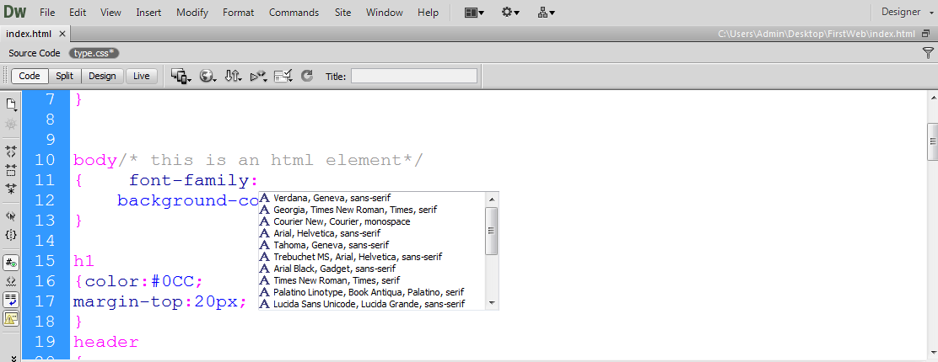
Font-family defines the font

Slide 18
Font-family defines the font
font-size
font-weight
font-variant
font-style

Slide 19
@font-face
Web designers do not have to use one of the “web-safe” fonts.
Make a font-face rule by giving the font a name:
font-family: myFont;
Include a font file somewhere on your server, and refer to it with CSS:
Src: url (‘font-name.tff’)

Slide 20
@font-face Syntax
@font-face
{
font-properties
}

Slide 21
@font-face
<div class="boxes">
<img height="150" src="images/html-logo.jpg" alt="HTML Logo">
<h3>HTML</h3>
</div>
<div class="boxes">
<img height="150" src="images/CSS3-logo.jpg" alt="CSS3 Logo">
<h3>CSS</h3>
</div>
<div class="boxes">
<img height="150" src="images/jQuery-logo.jpg" alt="jQuery Logo">
<h3>jQuery</h3>
</div>

Slide 22
@font-face
@font-face
{ font-family:Blackadder;
src:url(../font/Blackadder.TTF)
}
.boxes h3
{
font-family:Blackadder;
font-size:30px;
}

Slide 23

@font-face
Change Font

Slide 24
Designing hyperlinks
Links are text
We should make them box
Add padding and display:block to make it a box
Text-decoration is used for underline

Slide 25
Designing hyperlinks
<div style="clear:both"></div>
<a id="specialLink" href="#">View Tutorial</a>
#specialLink
{ display:block;
padding:10px;
background-color:#FFF;
border-radius:5px;
color:#903;
width:200px;
height:40px;
font-size:30px;
font-weight:bold;
text-decoration:none;
}

Slide 26
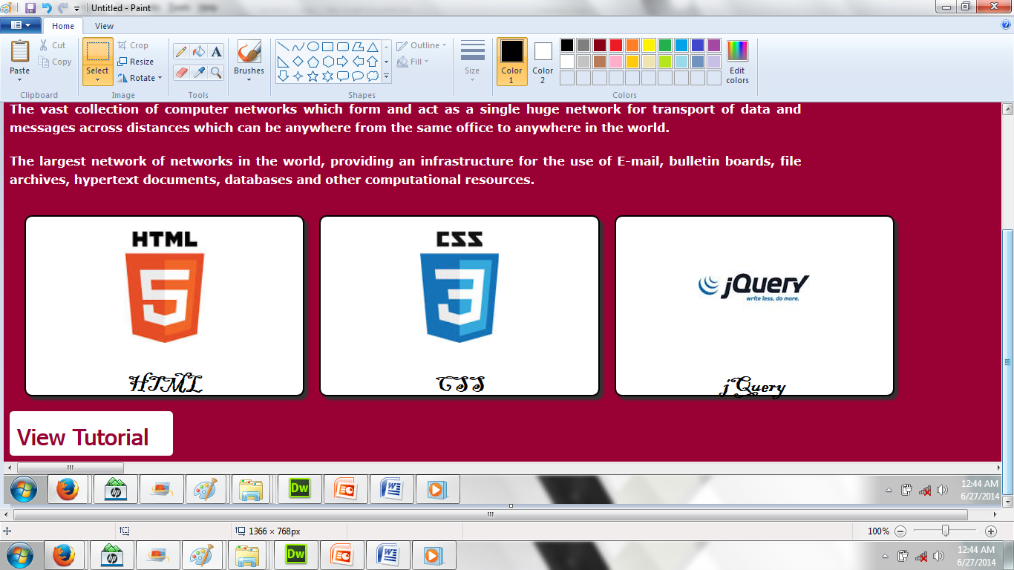
Designing hyperlinks
Designing Hyperlink

Slide 27
Google Fonts
Demo
https://www.google.com/fonts

Slide 28
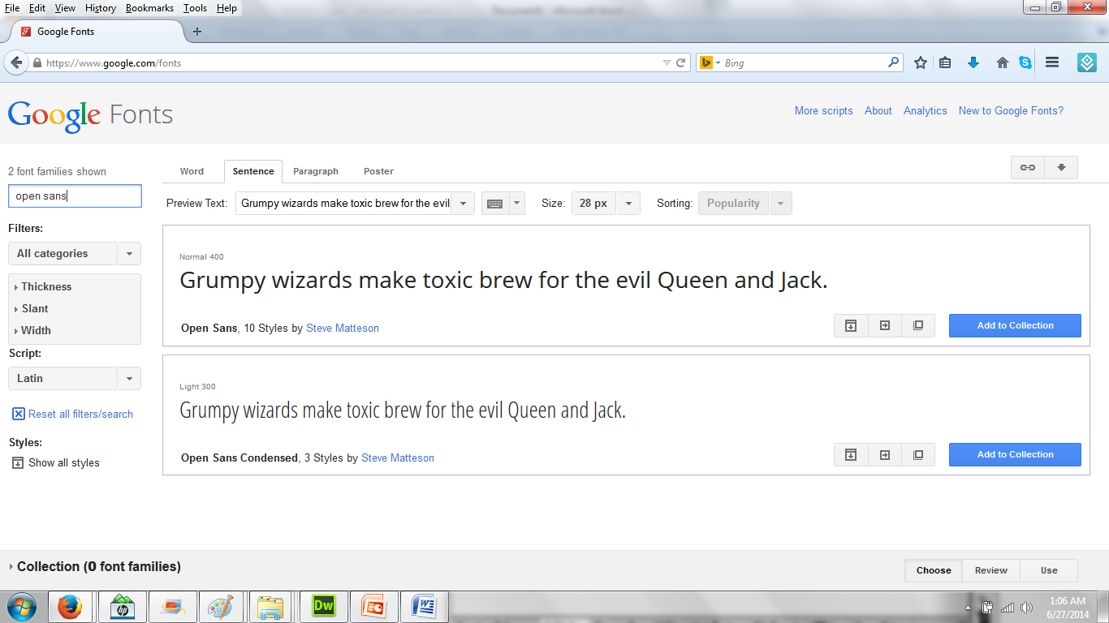
Google Fonts

Slide 29
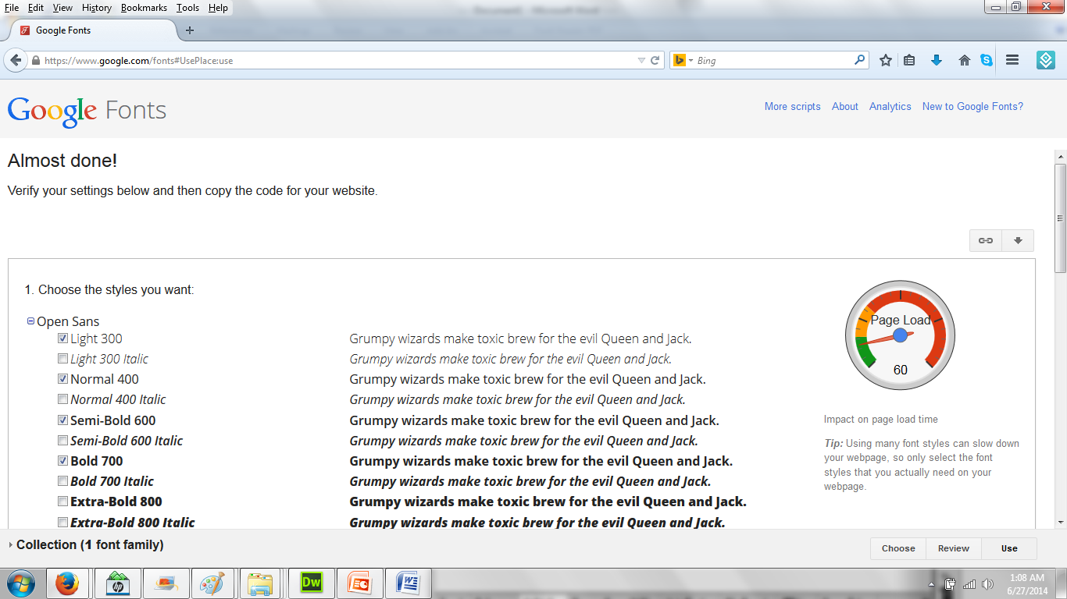
Google Fonts

Slide 30
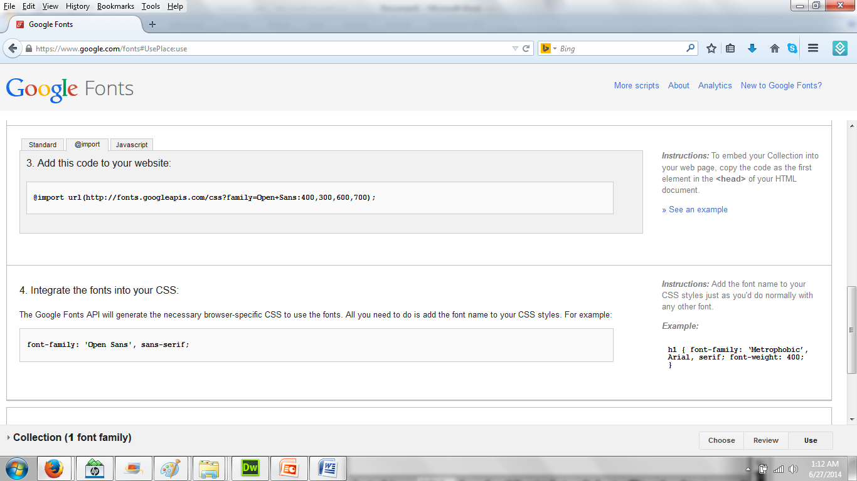
Google Fonts
Google fonts properties

Slide 31
Declaring Google Fonts
@import url(http://fonts.googleapis.com/css?family=Open+Sans:400,300,600,700);
h1
{color:#0CC;
font-weight:300;
font-family: 'Open Sans', sans-serif;
margin-top:20px;
font-size:40px;
}

Slide 32

Google Fonts
Change Google Fonts

Slide 33
Thank you!

